Slide 1
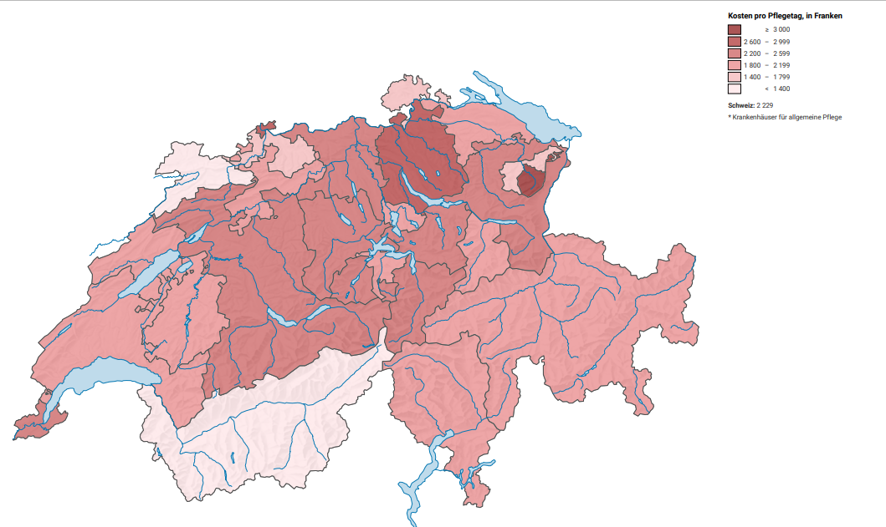
“Tackling the complex challenges of today through local data – what role can national and local statistical offices play?”
Costs of a day in hospital care in CHF
GEO_NAME | VALUE | UNIT
Zürich | 2739 | Franken
Bern | 2369 | Franken
Luzern | 2403 | Franken
Uri | 2207 | Franken
Schwyz | 2222 | Franken
Obwalden | 2415 | Franken
Nidwalden | 2158 | Franken
Glarus | 1913 | Franken
Zug | 2153 | Franken
Freiburg | 1855 | Franken
Solothurn | 1919 | Franken
Basel-Stadt | 2735 | Franken
Basel-Landschaft | 1565 | Franken
Schaffhausen | 1632 | Franken
Appenzell Ausserrhoden | 1713 | Franken
Appenzell Innerrhoden | 6137 | Franken
St. Gallen | 2398 | Franken
Graubünden | 2137 | Franken
Aargau | 2355 | Franken
Thurgau | 2187 | Franken
Tessin | 1850 | Franken
Waadt | 2067 | Franken
Wallis | 1380 | Franken
Neuenburg | 1892 | Franken
Genf | 2246 | Franken
Jura | 1255 | Franken

