Slide 1
Towards more coordinated climate action at the local level : introducing the Climate Change Data Ecosystem (CCDE) Approach

Slide 2
OUTLINE
Context: the climate change data challenge
Introducing the Climate Change Data Ecosystems approach (CCDE)
Applying the CCDE approach to country contexts

Slide 3
CONTEXT: CLIMATE CHANGE DATA CHALLENGE
UN Sustainable Development Agenda for 2030
Grenada’s National Sustainable Development Plan (NSDP)
Global goal frameworks
Use: analysis, accountability, transparency
Aggregated country level data
Need to focus more on:
Climate action for adaptation at national and local level
Notes:
A country may need data to report to the Paris Agreement and Sustainable Development Goals, but also to implement and evaluate national climate change policies

Slide 4
A FRAGMENTED CLIMATE CHANGE DATA LANDSCAPE TODAY
Data for climate reporting
National climate change reporting authorities
Administrative data
Ministries of Environment, Energy,
_{Agriculture}
Privately held data
Energy companies, oil companies, etc.
_{Citizen-generated data}
Geospatial/ satellite data
_{Land survey agencies}
Household surveys
_{National Statistical Offices}
Weather monitoring systems
_{Meteorological offices}
_{Climate Services}
Sub-national level data
Cities, Municipalities, Regional administrations

Slide 5
INTRODUCING THE CLIMATE CHANGE DATA ECOSYSTEMS (CCDE) APPROACH
Step 1
Identifying climate change data priorities within the ecosystem
Identify priority national climate change plans & policies
Assess feasibility of indicators
Step 2
Assessing capacity needs for an effective CCDE
Step 3
Mobilising a coherent and effective CCDE
Develop an action plan to mobilise a CCDE
Define a core set of impact climate change indicators
Identify and connect CCDE stakeholders
Launching the action plan
Determine key capacity for an inclusive and coherent CCDE

Slide 6
APPLYING THE CCDE APPROACH TO COUNTRY CONTEXT with support of Hewlett Foundation
Senegal case study jointly done with Open Data Watch and Center for Open Data Enterprise
Project objectives:
To assess national climate demand, connect data actors, and build required capacities;
To strengthen inter-agency coordination and develop an action plan to mainstream climate change data into sectoral and local policies;
To create a scalable collaboration model to help other countries leverage data to advance effective climate policy action.

Slide 7
INITIAL INSIGHTS GRENADA
Current situation
National Sustainable Development Plan - sectorial focus on climate change
Lack of priority climate indicators
Activities
Identify core set of priority indicators
Mapping exercise
Identify how to enhance capacities
Develop an action plan to mainstream climate change into national development plans

Slide 8
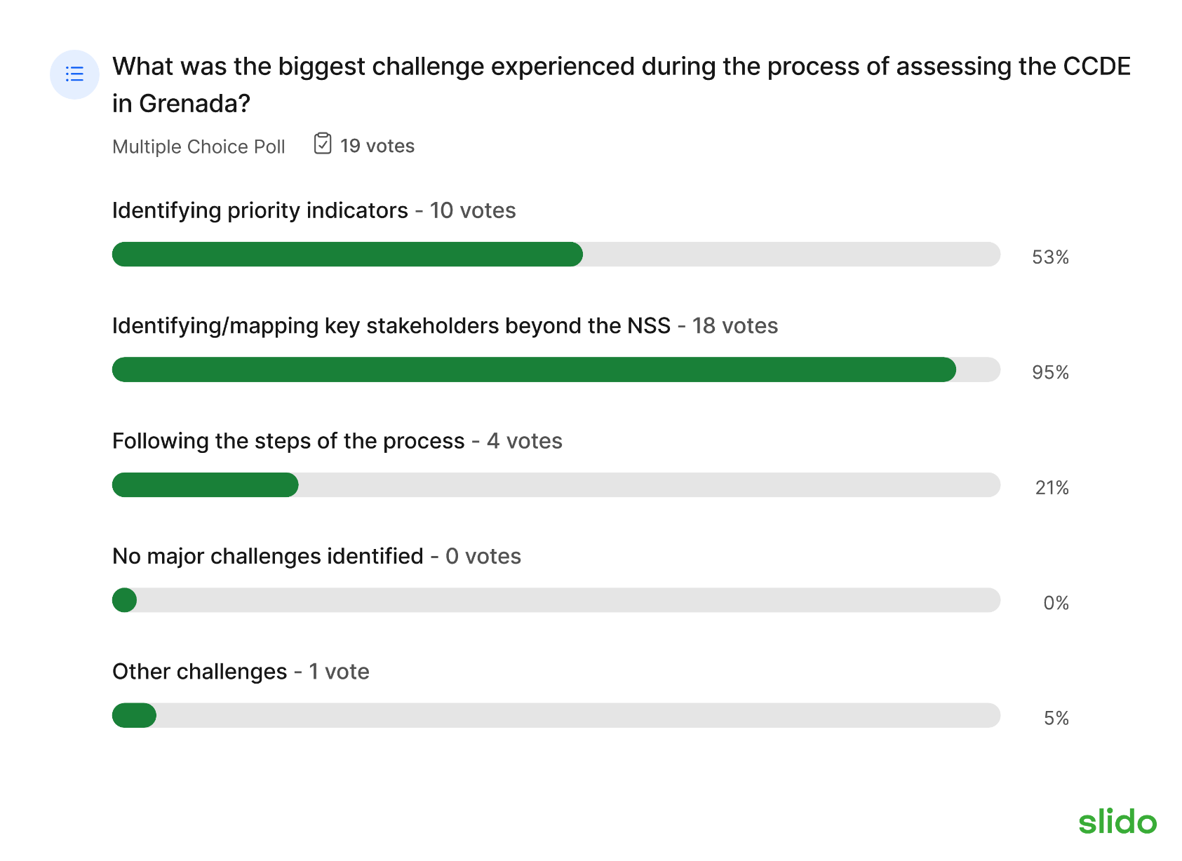
APPLYING THE CCDE APPROACH TO COUNTRY CONTEXT: First lessons learned- Grenada pilot
Lesson 1: Engagement and collaboration with local data actors are key to mobilise an effective CCDE
Yet,
Lesson 2: Mapping actors beyond the national statistical system is a major challenge
Results feedback survey from participants at the PARIS21 CCDE Workshop in Grenada, March 2023

Slide 9
NEXT STEPS: HIGHLIGHTS AND UP-COMING WORK
Developing a toolbox for mobilising national CCDEs
Integrating lessons learned & promoting peer review
Piloting & showcasing country cases – Senegal, Grenada, Belize, etc.
Building scalability with a focus on inclusiveness and adaptability dimensions
Notes:
​Integrate learnings from pilots to ensure AF’s adaptability to diverse national and local contexts
Scale up the inclusion of local institutions, local communities and vulnerable groups/ indigenous communities
Different dimensions to scale the CCDE AF up. With 1) being through regional clusters, 2) expanding the engagement of the ecosystem to vulnerable communities / indigenous comms to be more inclusive (LNOB angle) 3) through comparative approach, refine and upscale the tool into an open source, online process that can be used independently by countries if they wish, for maximum impact

Slide 10
THANK YOU!
FIND OUT MORE ABOUT PARIS21’S WORK ON
BETTER CLIMATE CHANGE DATA SYSTEMS
https://paris21.org/climate-change-data

