Slide 1

Local data and the AI4HealthyCities initiative
The Novartis Foundation
Peter Speyer
Head of Data, Analytics & AI
22 March 2023

Slide 2
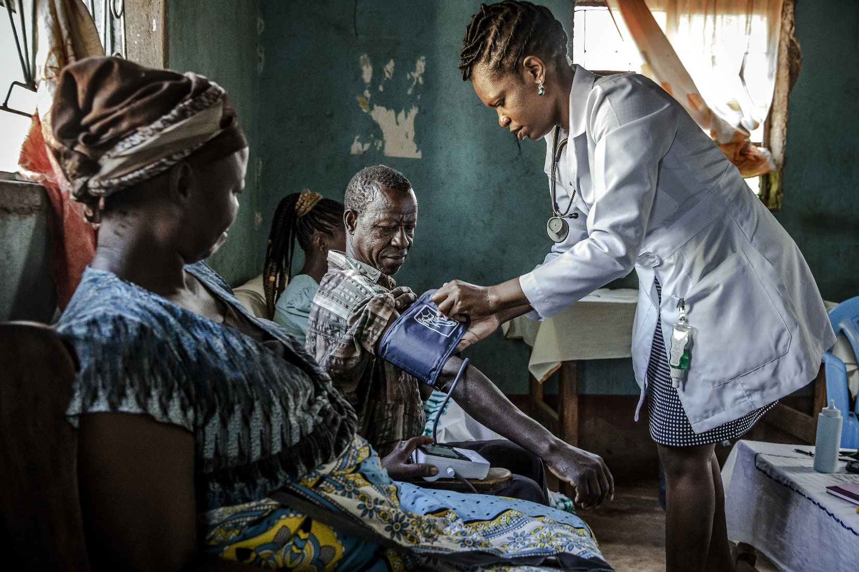



Slide 3





Slide 4




The Novartis Foundation
Using data, digital and AI-led innovations to improve CV population health & narrow health inequities
Influencing Population Health Policies and Actions
The CARDIO4Cities approach
to population health
AI4HealthyCities
Health Equity Network
Replicating & handing over CARDIO4Cities population health approach
Building an intervention simulator in São Paulo
Decipher drivers of health equity in data rich cities
Share insights through AI4HealthyCities Summits
Underpinned by the data collaborative for CV population health and regional HealthTech Hub(s)
supporting startups that bring the solutions for improving population health
4

Slide 5






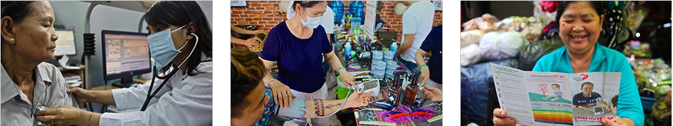


CARDIO4Cities approach toward urban CV population health
CARDIO4Cities Approach
Improve quality of CARE
Early ACCESS to health and care
REFORM policies with proven benefit
Leverage DATA and DIGITAL technology
INTERSECTORAL collaboration
Ensure local OWNERSHIP
https://www.novartisfoundation.org/urban-population-health-toolkit

Slide 6
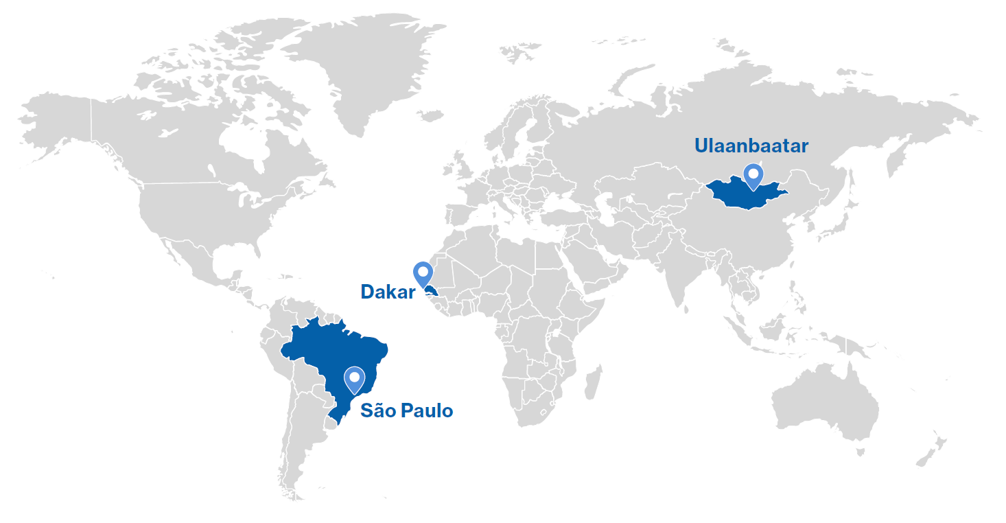



CARDIO4Cities Global Impact
Blood pressure control
CHD / stroke morbidity & mortality
Cost-effective
under WHO-CHOICE
Boch J et al. Implementing a multisector public-private partnership to improve urban hypertension management in low-and middle- income countries. BMC Public Health 22, 2379 (2022).
Reiker T and Des Rosiers S et al. Population health impact and economic evaluation of the CARDIO4Cities approach to improve urban hypertension management. PLOS Global Public Health (2023, in press)

Slide 7
Launching the
CARDIO4Cities Accelerator
Replicating the proven, data-driven CARDIO4Cities population health approach
Creating a neutral broker between city governments, health experts, industry, implementing partners, funders and investors
Adressing growing cardiovascular disease burden with focus on underserved populations
Interested in learning more or supporting the Accelerator?
Contact
johannes.boch
@novartis.com

Slide 8


Inequity is an issue and data & analytics an opportunity, everywhere
10-20%¹⁾
80-90%¹⁾
of health determined by healthcare ...
... by other
determinants of health
11 year lower life expectancy
for a child born in Brownsville,
New York, compared with a child
born in the Upper East Side
¹ Hood, C. M., K. P. Gennuso, G. R. Swain, and B. B. Catlin. 2016. County health rankings: Relationships between determinant factors and health outcomes. American Journal of Preventive Medicine 50(2):129-135. https://doi.org/10.1016/j.amepre.2015.08.024

Slide 9
The challenge: many determinants impact cardiovascular health
Events
Cardiovascular risk factors
Healthy choices
Increasing
individual effort
Genetics & demo-graphics
Environ-ment & climate
Built environ-ment
Social & cultural context
Education
Economic context
Behavi-oral risk factors
Health-care access & quality
Increasing
population
impact
Frieden T., A Framework for Public Health Action: The Health Impact Pyramid. American Journal of Public Health. 2010; 100(4): 590-595

Slide 10










AI4HealthyCities Health Equity Network
Data rich cities to decipher health inequity
Partnerships with data rich cities to generate insights on what drives CV health outcomes and equity
Partnerships being developed
In discussion
Helsinki
New York
US
Lausanne
Singapore
Singapore
New York
Lisbon
Dakar
Ho Chi Minh City
Lausanne
Switzerland
Singapore
Helsinki
Finland
São Paulo
São Paulo
Brazil
Lisbon
Portugal
10

Slide 11
AI4HealthyCities: from determinants to population health
Phase 3
Population health roadmap
Phase 1
Priority
setting
Phase 2
Data-driven insighs
Broad local stakeholder engagement
Collaboration with academia and Microsoft
AI for Health
Co-design with local decision-makers

Slide 12





Thank you
@NovartisFDN
Novartis Foundation
Novartis Foundation
www.novartisfoundation.org

